Slide 1
E-Farm System
Presented By
Ashok Pandit

Slide 2
Agenda
Introduction
Existing System
New System
Data Flow Diagram
Use Case Diagram
Activity Diagram
ER Diagram
Data Disctionary

Slide 3
Introduction
E-farming System that will help the farmers to achieve success and increase in their standard of living.
Website will also provide In rural area, the SMS facility would give the required market information where internet cannot be availed.

Slide 4
Existing System
does not provide proper guidance to farmer how to sell their machineries online.
The current system does not provide websites to farmer in their local language.
The farmer have to go physical in market for process.

Slide 5
System Flow diagram
Start
Customer visits Farmer
Customer select machinery
Pay to farmer
Stop

Slide 6
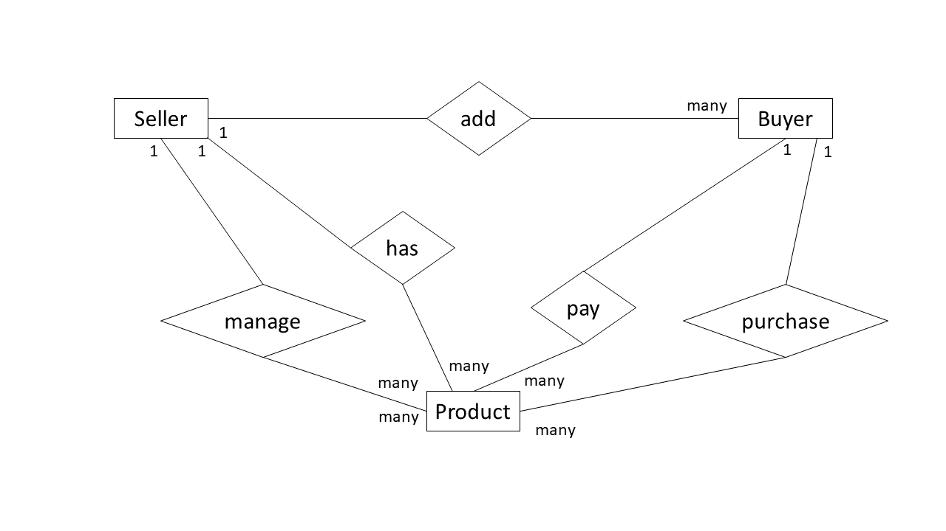
E-R Diagram
Add
Sa
Buyer
has
pay
manage
purchase
Prouduct

Slide 7
New System
system will help farmers from Indian villages to sell their products to different city markets.
This Project Will be helpful for farmers to know more about market information
The purchasing and selling of product over the internet without need of the going the market

Slide 8
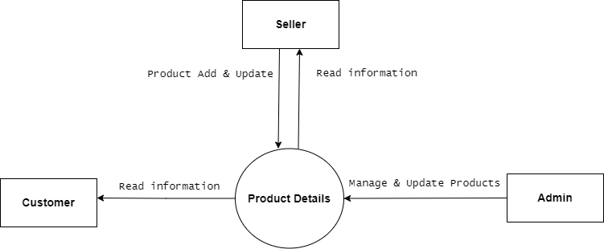
Data Flow Diagram : 0 Level

Slide 9
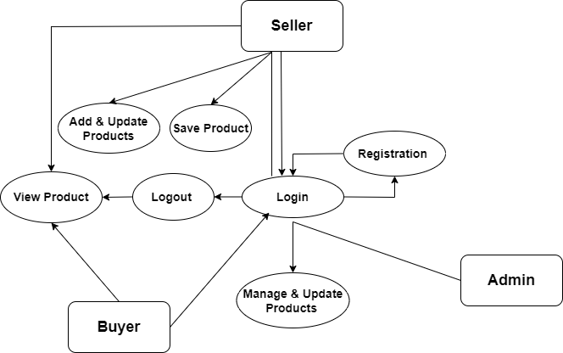
Data Flow Diagram : 1 Level

Slide 10
Use-Case
Admin
Buyer
Seller
Login
View Categories
View Subcategories
Add Item
Manage Details
Update Profile
Change Password
Logout
Login---->Sign Up
View Categories
View Subcategories
Update Profile
Change Password
Wishlist
Logout
Login---->Sign Up
Add Items
Manage Details
Update Profile
Change Password
Logout

Slide 11
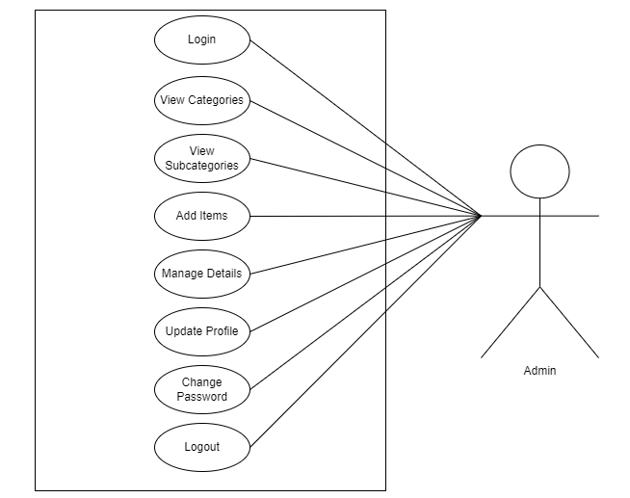
Use-Case Diagram : Admin

Slide 12
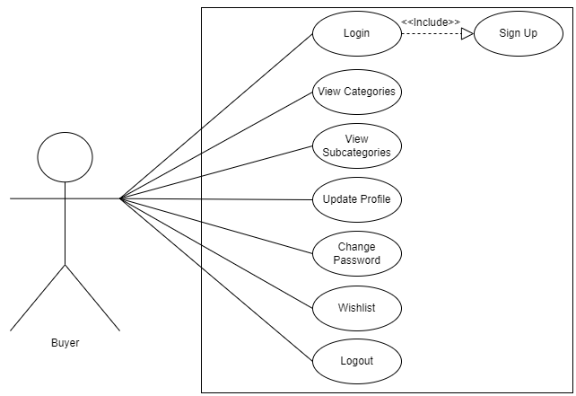
Use-Case Diagram : Buyer

Slide 13
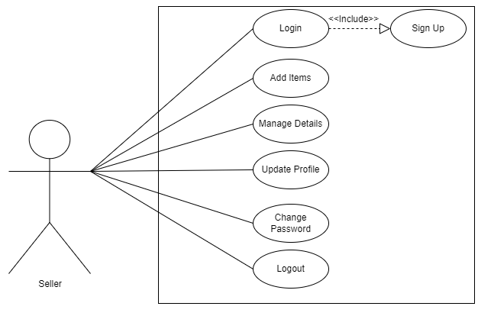
Use-Case Diagram : Seller

Slide 14
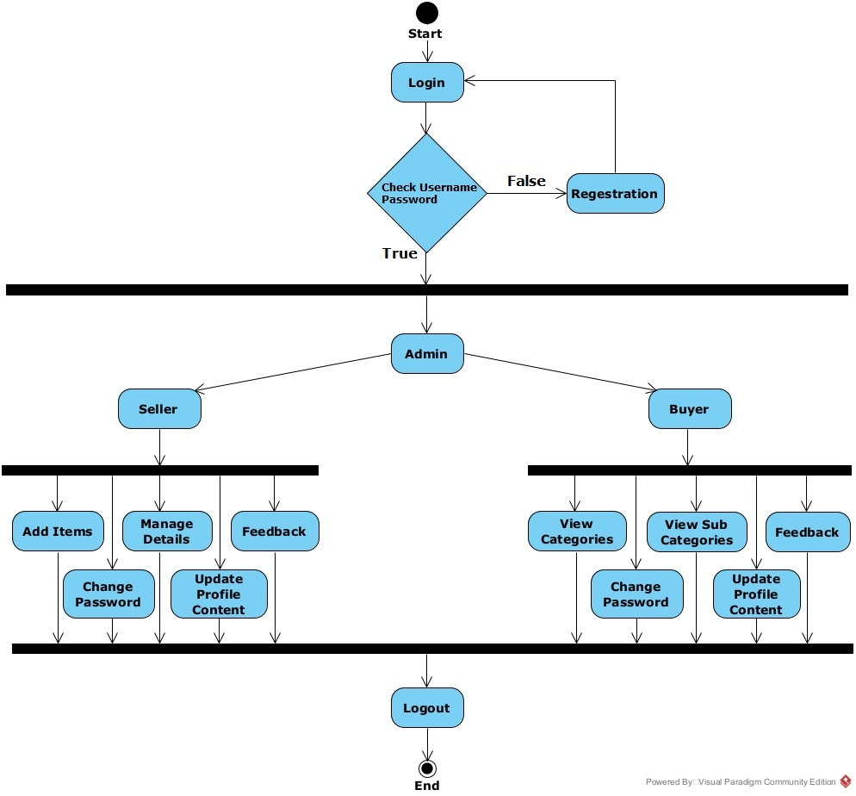
Activity Diagram

Slide 15
Data Dictionary
Seller
Buyer
Product

Slide 16
Thank You

